Slide 1
CLIENT-SIDE SCRIPTS
Course Code: CSC 4164
Course Title: ADVANCED PROGRAMMING WITH .NET
Dept. of Computer Science
Faculty of Science and Technology
Lecture No: | 10 | Week No: | 06 | Semester: | Fall 2020-21
Lecturer: | Victor Stany Rozario, stany@aiub.edu

Slide 2
Lecture Outline
CSS, JS and JSON
Adding CSS and JS with mvc application
Adding 3rd party libraries (Bootstrap & Jquery)
Using Ajax
Bundling and Minification using Microsoft Web Optimization Framework

Slide 3
CSS, JS and JSON
Cascading Style Sheets(CSS)
Cascading Style Sheets (CSS) is a stylesheet language used to add styles in a Web page — for example, to alter the font, color, size, and spacing of your content, split it into multiple columns, or add animations and other decorative features. It describes the presentation of a document written in HTML or. CSS describes how elements should be rendered on screen, on paper, in speech, or on other media to make it more presentable.
The CSS syntax reflects this goal and its basic building blocks are:
The property which is an identifier, that is a human-readable name, that defines which feature is considered.
The value which describe how the feature must be handled by the engine. Each property has a set of valid values, defined by a formal grammar, as well as a semantic meaning, implemented by the browser engine.

Slide 4
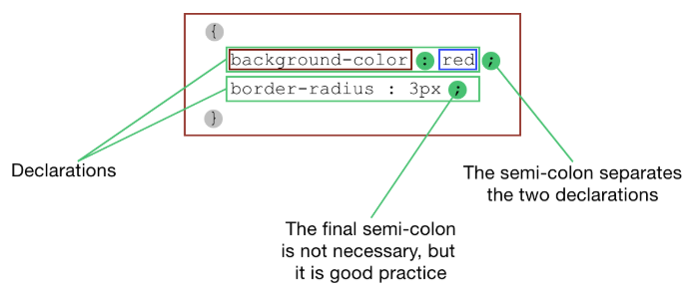
A CSS declaration block is visualized in the below diagram.

Slide 5
CSS, JS and JSON
JavaScript (JS)
JavaScript was introduced in 1995 as a way to add programs to web pages in the Netscape Navigator browser.
Many desktop and server programs use JavaScript. Node.js is the best known. Some databases, like MongoDB and CouchDB, also use JavaScript as their programming language.
JavaScript is a scripting or programming language that allows you to implement complex features on web pages — every time a web page does more than just sit there and display static information for you to look at — displaying timely content updates, interactive maps, animated 2D/3D graphics, scrolling video jukeboxes, etc. It is the third layer of the layer cake of standard web technologies, two of which (HTML and CSS) we have covered in much more detail in other parts of the Learning Area.

Slide 6
CSS, JS and JSON
JavaScript Object Notation (JSON)
JavaScript Object Notation (JSON) is an alternative to XML for representing data. JSON is a text-based data-interchange format used to represent objects in JavaScript as collec- tions of name/value pairs represented as strings. It’s commonly used in Ajax apps. JSON is a simple format that makes objects easy to read, create and parse, and allows programs to transmit data efficiently across the Internet because it is much less verbose than XML. Each JSON object is represented as a list of property names and values contained in curly braces.
propertyHame1 : value1 , properrfHame2 : value2 ]
Arrays are represented in JSON with square brackets in the following format:
[ value1 , value2, value3 ]

Slide 7
Adding CSS and JS with mvc application
Right-click on Contents→ Add a new Folder named “Style”
Right-click on the Style folder→ Select Add → Select New item
Select Style sheet → Provide name and then select OK.
Add css contents on the file.
Add reference to the cshtml file as:
<link href=“~/filename.css“ rel=“stylesheet” type=“text/css” />
Right-click on Contents→ Select the folder named “Scripts”
Right-click on the Scripts folder→ Select Add → Select New item
Select JavaScript File→ Provide name and then select OK.
Add javascript code on the file.
Add reference to the cshtml file as:
<script src=“filename.js"></script>

Slide 8
Adding 3rd party libraries (Bootstrap & Jquery)
In order to add a 3rd party library, you will have to download the files such as for Bootstrap- download its .js and .css files.
After downloading the files, place the files according to its place, .js files to Scripts folder and .css files to Styles folder.
Add reference to the .cshtml file as:
<link href=“~/filename.css“ rel=“stylesheet” type=“text/css” />
<script src=“filename.js"></script>

Slide 9
Ajax
Asynchronous JavaScript and XML, while not a technology in itself, is a term that describes a "new" approach to using a number of existing technologies together, including HTML or XHTML, CSS, JavaScript, DOM, XML, XSLT, and most importantly the XMLHttpRequest object.
When these technologies are combined in the Ajax model, web applications are able to make quick, incremental updates to the user interface without reloading the entire browser page. This makes the application faster and more responsive to user actions.

Slide 10
Advantages
HTML and CSS for structuring and styling information.
JavaScript for accessing and manipulating information dynamically.
XMLHttpRequest, which is an object provided by modern browsers for exchanging data with the server without reloading the current web page.
A format for transferring data between the client and server. XML is sometimes used, but it could be HTML, plain text, or a JavaScript-based format called JSON.
Better user experience. With Ajax, the user can do a lot without refreshing the page, which brings web applications closer to regular desktop applications.
Better performance. By exchanging only the required data with the server, Ajax saves bandwidth and increases the application’s speed

Slide 11
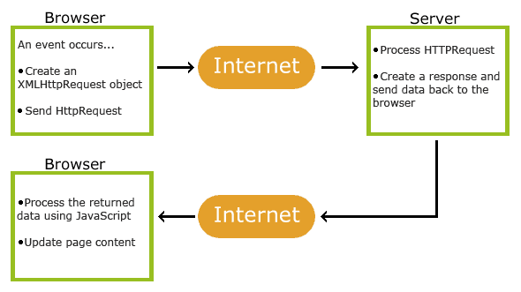
How Ajax works
1. An event occurs in a web page (the page is loaded; a button is clicked)
2. An XMLHttpRequest object is created by JavaScript
3. The XMLHttpRequest object sends a request to a web server
4. The server processes the request
5. The server sends a response back to the web page
6. The response is read by JavaScript
7. Proper action (like page update) is performed by JavaScript

Slide 12
A simple example
<!DOCTYPE html>
<html>
<body>
<div id="demo">
<h2>Let AJAX change this text</h2>
<button type="button" onclick="loadDoc()">Change Content</button>
</div>
</body>
</html>
function loadDoc() {
var xhttp = new XMLHttpRequest();
xhttp.onreadystatechange = function() {
if (this.readyState == 4 && this.status == 200) {
document.getElementById("demo").innerHTML = this.responseText;
}
};
xhttp.open("GET", "ajax_info.txt", true);
xhttp.send();
}
The <div> section is used to display information from a server.
The <button> calls a function (if it is clicked).
The function requests data from a web server and displays it:

Slide 13
The following example will demonstrate how a web page can
fetch information from a database with AJAX:
<form action="">
<select name="customers" onchange="showCustomer(this.value)">
<option value="">Select a customer:</option>
<option value="ALFKI">Alfreds Futterkiste</option>
<option value="NORTS ">North/South</option>
<option value="WOLZA">Wolski Zajazd</option>
</select>
</form>
<br>
<div id="txtHint">Customer info will be listed here...</div>
<script>
function showCustomer(str) {
var xhttp;
if (str == "") {
document.getElementById("txtHint").innerHTML = "";
return;
}
xhttp = new XMLHttpRequest();
xhttp.onreadystatechange = function() {
if (this.readyState == 4 && this.status == 200) {
document.getElementById("txtHint").innerHTML = this.responseText;
}
};
xhttp.open("GET", "getcustomer.php?q="+str, true);
xhttp.send(); }

Slide 14
Bundling and Minification using Microsoft Web Optimization Framework
Bundling: This feature was introduced in ASP.NET 4.5 and reduces the number of requests to server. ...
Minification: This feature reduces the size of requested resources in order to optimize code by shortening the variable names, remove white spaces, tabs, comments, etc.
There are two ways to enable or disable Bundling and Minification:
Using Web.config: In web.config, you can set debug attribute of compilation element as follows:
<system.web>
<compilation debug="true" />
</system.web>

Slide 15
By setting EnableOptimizations: Set this to true for bundling and minification as follows:
public static void RegisterBundles(BundleCollection bundles)
{
bundles.Add(new ScriptBundle("~/bundles/jquery").Include(
"~/Scripts/jquery-{version}.js"));
BundleTable.EnableOptimizations = true;
}
Bundle Class
This class has Include method which takes an array of strings, where each string is a virtual path to resource. We can add multiples files as follows:
bundles.Add(new StyleBundle("~/Content/themes/base/css").Include(
"~/Content/themes/base/jquery.ui.autocomplete.css",
"~/Content/themes/base/jquery.ui.accordion.css",
"~/Content/themes/base/jquery.ui.selectable.css",
"~/Content/themes/base/jquery.ui.code.css",
"~/Content/themes/base/jquery.ui.button.css",));

Slide 16
We can use patterns while searching files or subdirectories by using “*” wildcard character as follows:
Include(“~/Scripts/Common/*.js”) ===> this will include all js files.
IncludeDirectory(“~/Scripts/Common”,”T*.js”) ===> this will include all js files whose name starts from T.
Now, the next question is we have created bundles, now how will we include in view or aspx file?
We will use Styles.Render for CSS and Scripts.Render for script file as follows:
@Styles.Render("~/Content/theme/base/css","~/Content/css");
@Scripts.Render("~/bundles/jquery");

Slide 17
Now follow the steps to add in your application:
Now, you need to install this framework in your website so open NuGet Package Manager console as per screenshot.
Write command “Install - Package Microsoft.AspNet.Web.Optimization” and press enter. It will install ASP.NET Optimization Framework in your web site.
You can check in bin folder required DLLs have been added.
Now you need to create two folders, Scripts and Styles for keeping scripts and CSS files.
Add Global.asax file in your website in the following way:
Right click on solution explorer
Click on Add and from submenu, select Add new item
Select Global.aspx file
You can see that there are many events in Global.asax file. Focus on Application_Start event here. You need to write the following code inside this event.

Slide 18
System.Web.Optimization.BundleTable.Bundles.Add(new System.Web.Optimization.ScriptBundle("~/bundle/js")
.Include("~/Scripts/*.js"));
System.Web.Optimization.BundleTable.Bundles.Add(new System.Web.Optimization.StyleBundle("~/bundle/css")
.Include("~/Styles/*.css"));
You can further classify a single bundle into other sub bundles. One more thing you might have noticed here is *.js, because we are adding all js files into one bundle and same for CSS. Here we bundled all JavaScript files into one bundle, it means they will load as a single entity not as multiple different files and same for CSS, created a single bundle for all CSS files.
Now we are ready with our bundle, so the last task is to include this bundle into our aspx file. That we can do by using Scripts.Render and Styles.Render method as follows:
<%: System.Web.Optimization.Scripts.Render("~/bundle/js") %>
<%: System.Web.Optimization.Styles.Render("~/bundle/css") %>

Slide 19
Now only one task is remaining, i.e., enabling the bundling and minification. As discussed, there are two ways to enable it. So you can use either of the ways. Here enabling by setting web.config file’s compilation elements’s debug attribute as shown below:
<system.web>
<compilation debug="false" />
</system.web>

Slide 20
Books
Beginning ASP.NET 4: in C# and VB; Imar Spaanjaars,2010
Beginning ASP.NET 3.5 in C# 2008: From Novice to Professional; 2nd edition, Matthew MacDonald,2007
ASP.NET 3.5 Unleashed by Stephen Walther, 2008
Pro ASP.NET 3.5 in C# 2008: Includes Silverlight 2 by Matthew MacDonald,2008
ASP.NET 3.5 For Dummies by Ken Cox,2008

Slide 21
References
ASP.NET; URL: https://www.got-it.ai/solutions
URL: https://www.tutorialspoint.com/
URL: https://www.c-sharpcorner.com/a
URL: https://developer.mozilla.org/
URL:https://www.codeproject.com/
URL: https://www.w3schools.com/
URL: http://www.mukeshkumar.net/

Slide 22
Thank you!

